Slide 1

College of Engineering & Computing Sciences
A CoECS Interim Undergraduate Report submitted for CSCI-318-M01-Programing Language Concepts
Instructor Name: Wenjia li
Group Members
Muhammad Usman (Student ID: 1299708)
Michael Aryeetey (Student ID: 1284978)
Elsabeth Assaye (Student ID: 1294216)
Gurpinder Singh (Student ID: 128990)

Slide 2
Title: HealthBoost
A Personalized Nutrition and Workout App for Improved Health and Wellness.
Introduction:
Health-Boost is a personalized nutrition and workout app designed for individuals looking to improve their health and wellness. This interim report provides an update on the progress of its development, including an overview of the app's purpose, motivation, and key technologies used.
Big Picture:
Health-Boost is a personalized nutrition and workout app designed for individuals looking to improve their health and wellness. This interim report provides an update on the progress of its development, including an overview of the app's purpose, motivation, and key technologies used.

Slide 3
Motivation:
The motivation behind the Health-Boost app is to address the need for personalized nutrition and workout plans, providing a comprehensive wellness solution that meets users' specific needs and preferences. Its personalized plans, based on dietary restrictions, health goals, and fitness level, make it easier for users to achieve their health and wellness goals.
Key Technologies:
The Health-Boost app utilizes React Native for the front-end and Node.js for the back-end, along with SQL for the database and RESTful API for secure data transfer. These key technologies provide a scalable and efficient way to develop mobile and web applications with a single codebase.

Slide 4
Detailed Key Technologies (How/Why we used):
React Native:
is a cross-platform JavaScript framework used for building mobile applications, providing an efficient way for the development and deployment of such apps. It's being used for the front-end of HealthBoost to create a seamless user experience on both web and mobile devices, allowing for easy customization of UI components to ensure a user-friendly and intuitive interface.
Node.js: is a server-side environment built on Chrome's V8 JavaScript engine, offering a fast and scalable solution for server-side scripting. It's being used to develop the backend of HealthBoost, providing non-blocking I/O operations, making it ideal for handling a large volume of requests and data.
SQL: is a standard language for managing relational databases, providing a reliable and efficient way to manage data. It's being used to build the database for the HealthBoost app, which requires storing and managing sensitive user data, as SQL databases are known for their scalability, security, and ease of use.
RESTful API: is a standard architectural style for building web services, allowing for a lightweight and scalable way to transmit data between different components of an app. It's being used to communicate between the front-end and back-end of HealthBoost, supporting a wide range of programming languages and platforms, making it easy to integrate with other tools and services.

Slide 5
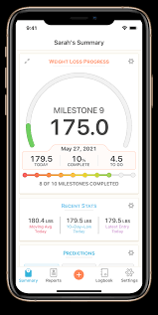
EasyTiger
Zero
FastEasy
LoseIt
Happy Scale
Noom
Similar Apps (Related Works):
There are several similar apps in the market that offer personalized nutrition and workout plans to users. Some of the notable ones include:

Slide 6
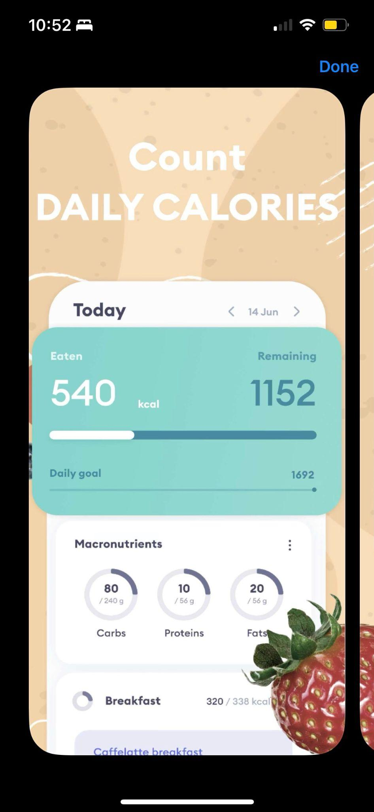
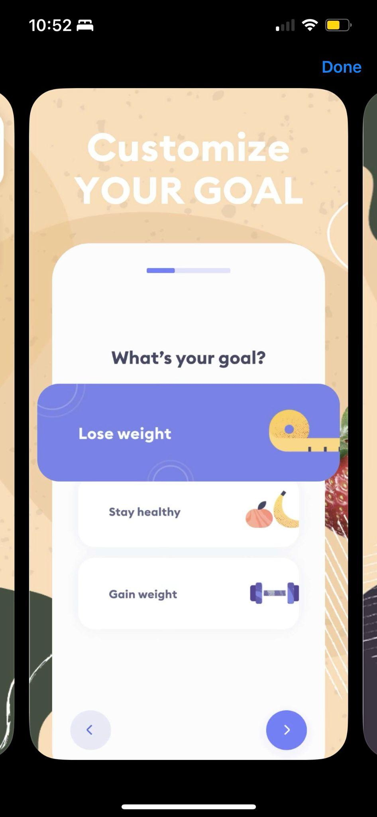
EasyTiger [1] : A personalized nutrition and workout app can be a useful tool to help improve health and wellness. Here are some potential features, pros, and cons of such an app:
Pros:
Customizable to individual needs: Users can set personalized goals, track progress, and choose from a variety of weight loss plans, making it easier to find a plan that works for them.
Provides visual representation of progress: The app provides graphs and charts that show your progress over time, which can help you stay motivated and track your success.
Cons:
May not be effective for everyone: While the app may be helpful for some users, it may not be effective for everyone in achieving their weight loss goals, as successful weight loss depends on factors beyond just calorie tracking.
The app primarily focuses on calorie tracking, which may not be suitable for users with specific dietary needs, such as those following a low-carb, keto or low-fat diet.

Slide 7
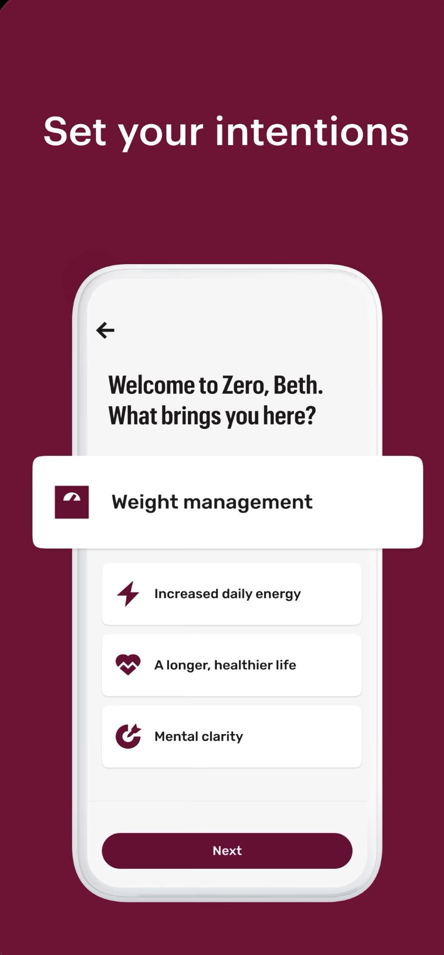
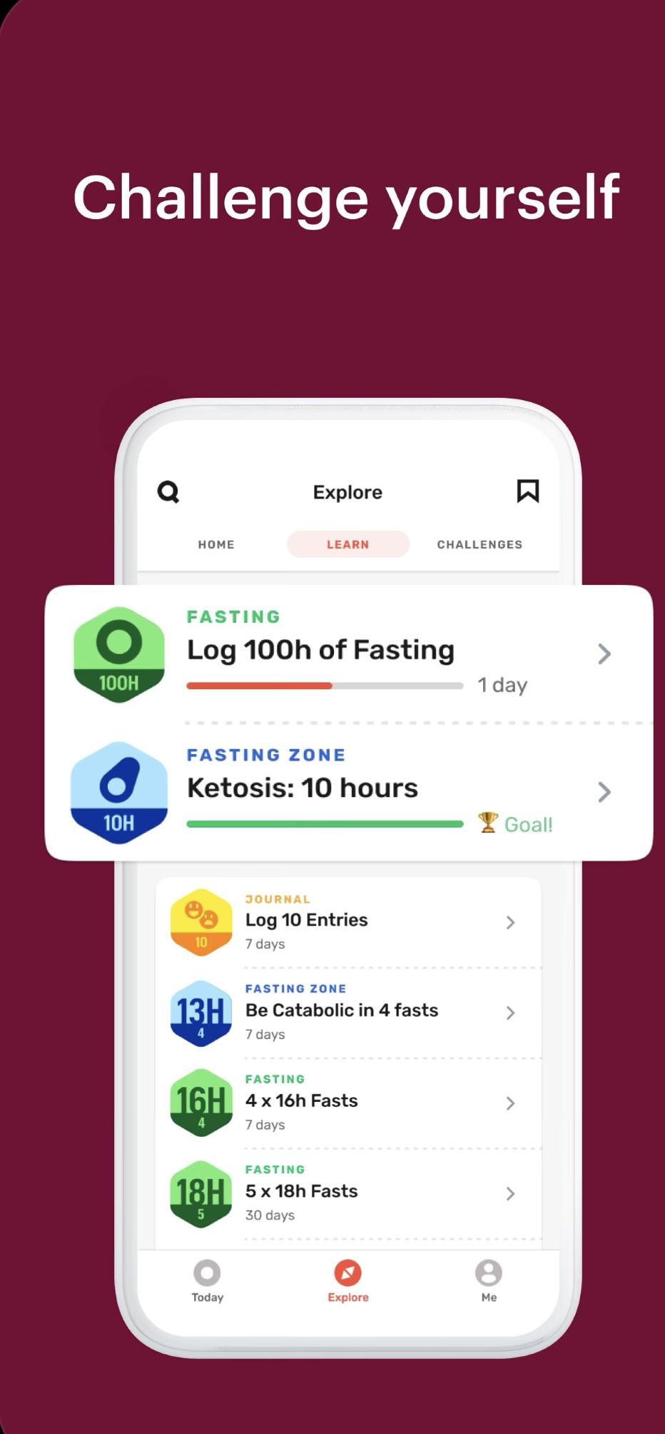
Zero fasting and health tracker is an app that allows users to track their fasting schedules, water intake, weight, and other health metrics. Here are some potential features, pros, and cons of such an app:
Pros:
Health metrics tracking: The app allows users to track their weight, body measurements, and other health metrics, which can help them monitor their progress and make adjustments to their fasting plans.
Customizable fasting plans: The app allows users to customize their fasting plans based on their goals and preferences, such as the duration and frequency of fasting.
Cons:
Potential for unhealthy behaviors: Some users may develop unhealthy behaviors or attitudes towards food or fasting, such as binge-eating, eating disorders or obsessive fasting. It's important to use the app in a healthy and balanced way.
Cost: The app may require a subscription or payment for certain features, which may be a barrier for most users.

Slide 8
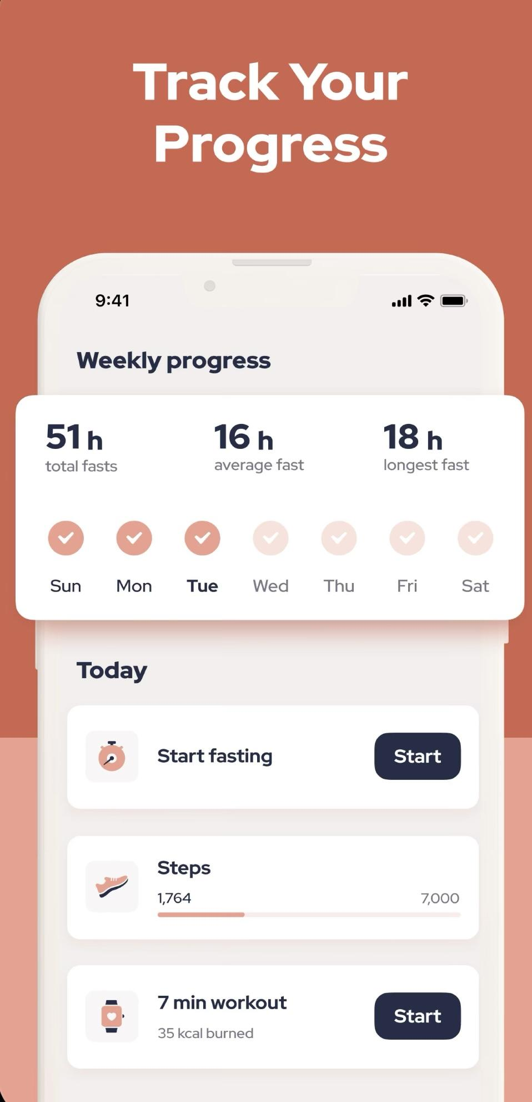
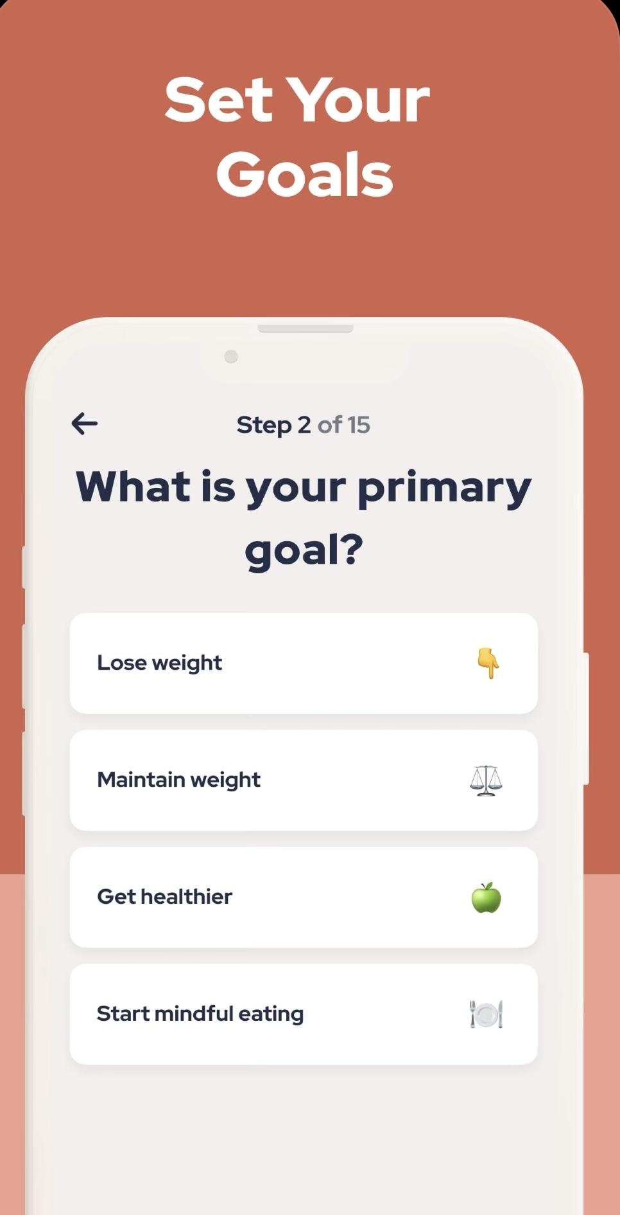
FastEasy: Intermittent Fasting is an app designed to help users with their intermittent fasting goals. Here are some potential features, pros, and cons of such an app:
Pros:
Easy to use: The app is user-friendly and straightforward, making it easy for users to track their fasting schedules and progress.
Customizable fasting plans: The app allows users to customize their fasting plans based on their goals and preferences, such as the duration and frequency of fasting.
Cons:
Potential for unhealthy behaviors: Some users may develop unhealthy behaviors or attitudes towards food or fasting, such as binge-eating or obsessive fasting.
Limited guidance: The app may not provide enough guidance or support for users who are new to intermittent fasting or who have questions about their fasting plans.

Slide 9
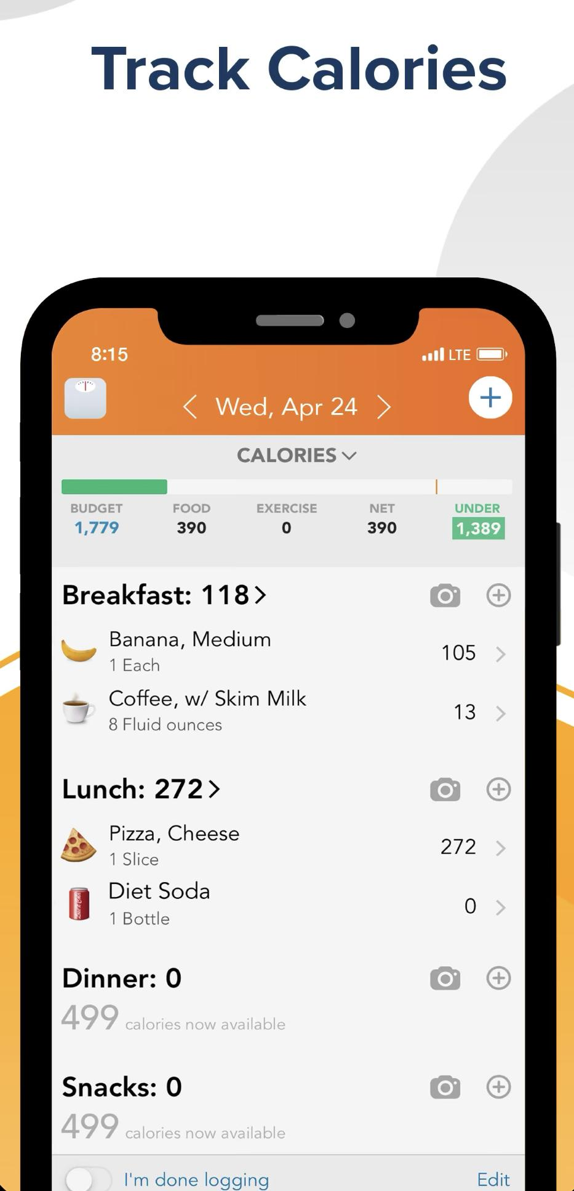
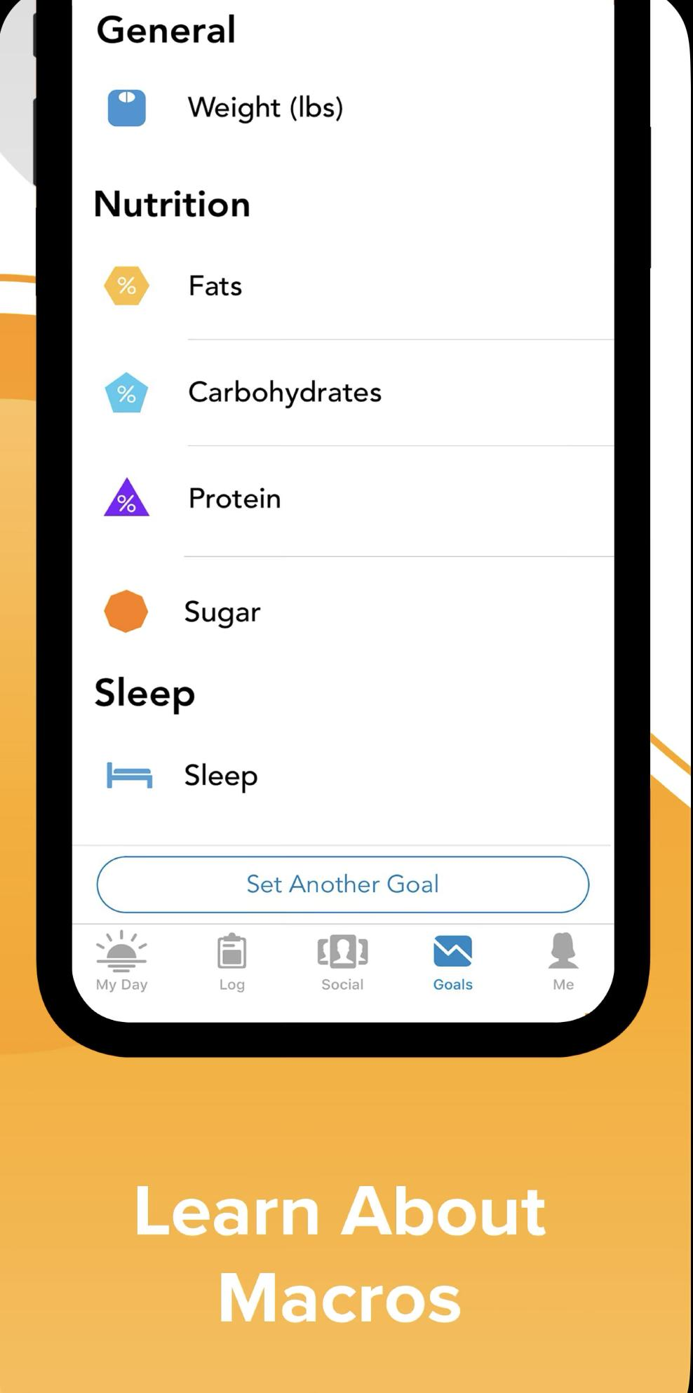
Lose It! is a popular calorie counting app that can help users achieve their weight loss goals. Here are some potential features, pros, and cons of such an app:
Pros:
Easy to use: Lose It! has a user-friendly interface that makes it easy to track calories and monitor progress.
Customizable goals: Users can set customized goals for weight loss and track progress towards those goals.
Cons:
Limited free version: The free version of the app is somewhat limited in terms of functionality, and users may need to upgrade to the premium version to access all features.
Can be time-consuming: Tracking every meal and snack can be time-consuming, and some users may find it difficult to stick to the app's calorie-tracking requirements over the long term.

Slide 10
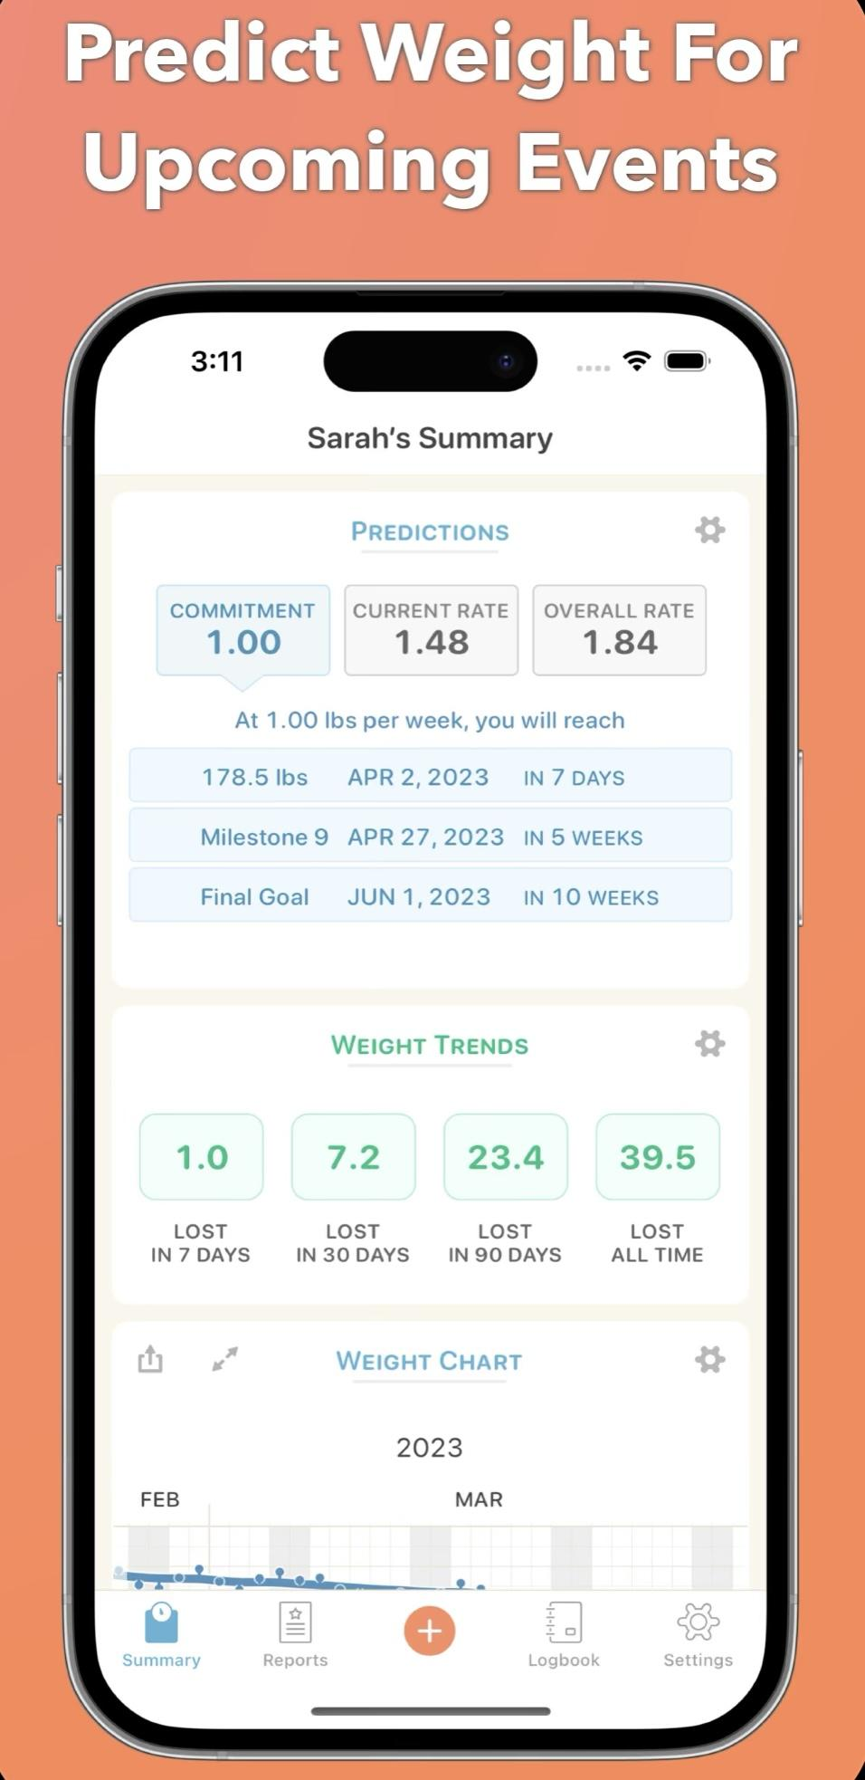
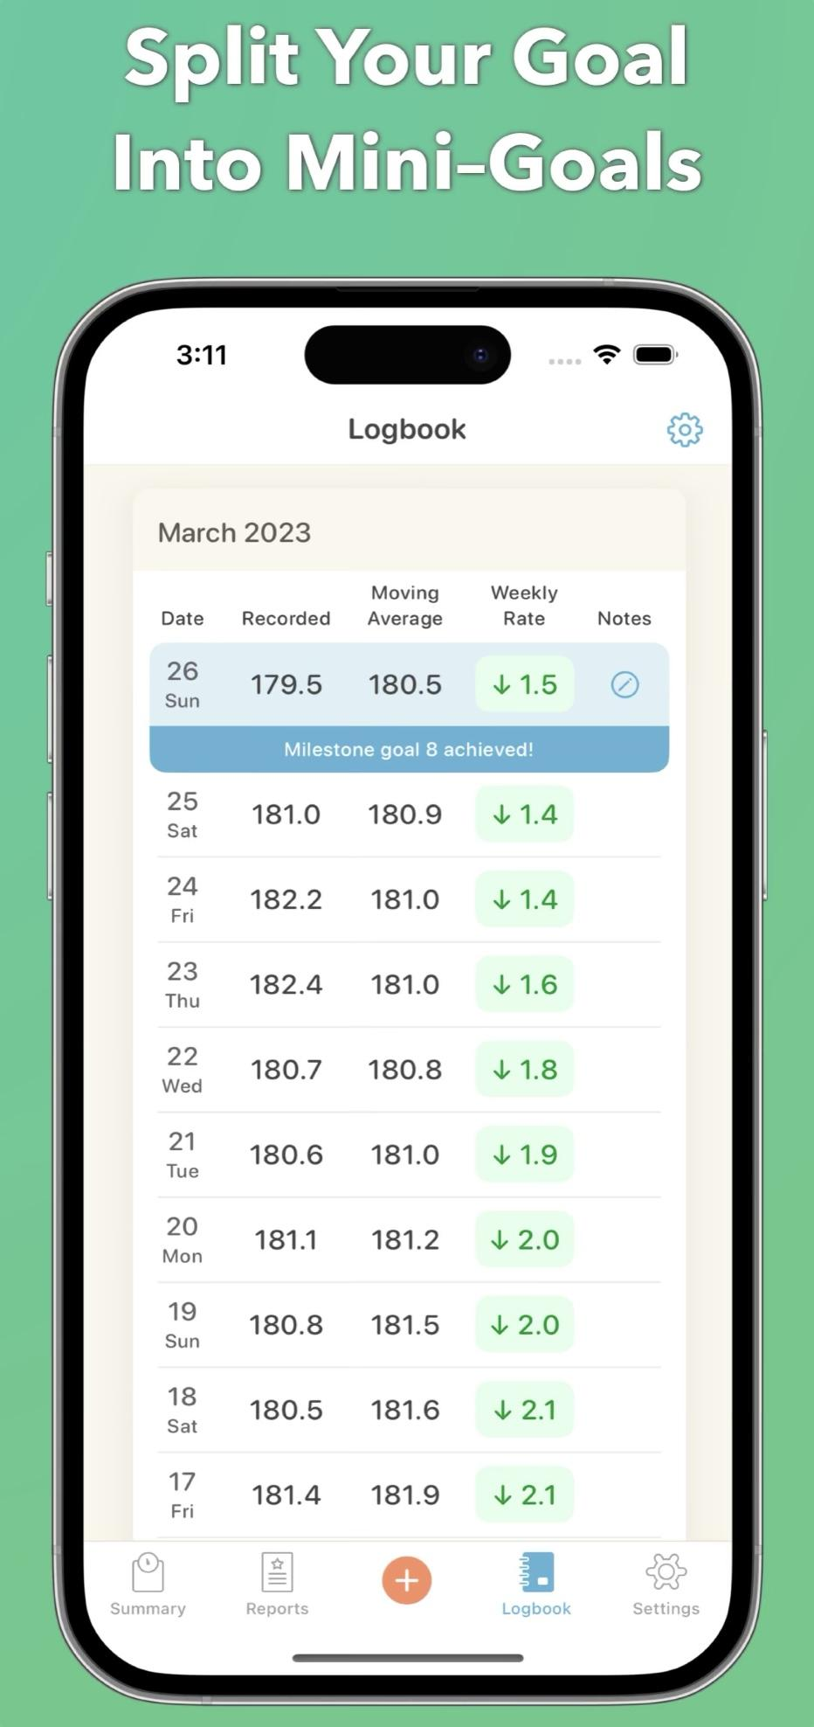
Happy Scale is an app that helps users track their weight loss progress and provides tools to stay motivated.
Pros:
Customizable goals: Users can set customizable weight loss goals and track their progress towards those goals.
Weight trends analysis: Happy Scale provides users with detailed analysis of their weight trends over time, which can be helpful in identifying patterns and making adjustments to their weight loss plans.
Cons:
Paid features: Some of the more advanced features of the app, such as the ability to sync with other health apps or export data, require a paid subscription.
Limited social support: While Happy Scale allows users to share their progress with friends and family, it doesn't have a built-in social support community like some other weight loss apps.

Slide 11
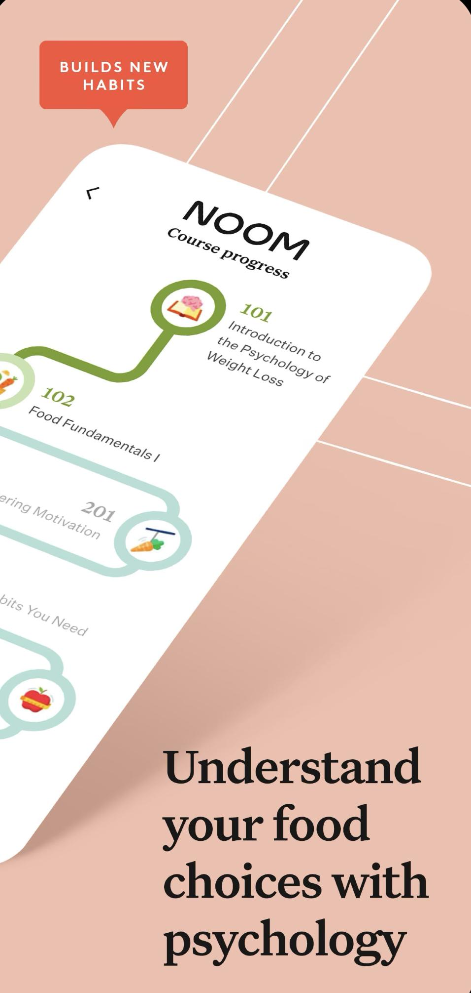
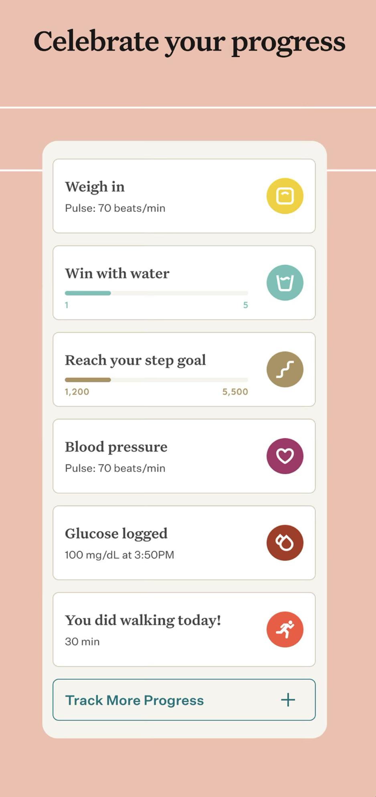
Noom is a popular weight loss app that uses a behavioral approach to help users make healthier choices and develop sustainable habits.
Pros:
Behavioral coaching: The app provides users with daily coaching and support from a certified coach, who helps them identify and overcome barriers to weight loss.
Food logging: Noom includes a food logging feature that allows users to track their meals and snacks, and provides feedback on the nutritional value of their choices.
Cons:
Expensive: Noom is a paid app that requires a subscription, which can be expensive for some users.
Limited customization: Noom's program is relatively rigid, and may not provide enough customization for users with unique goals or needs.

Slide 12
Screenshots of our Front End

Slide 13
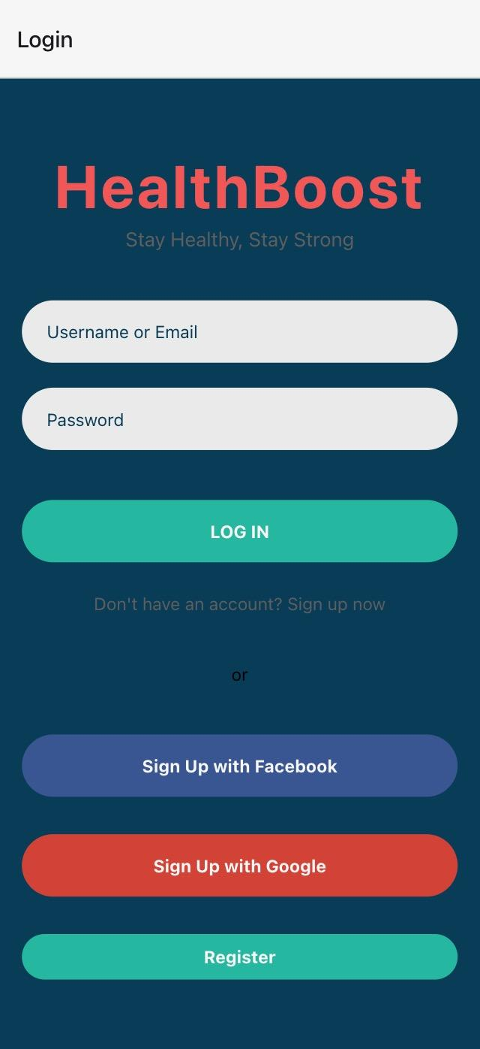
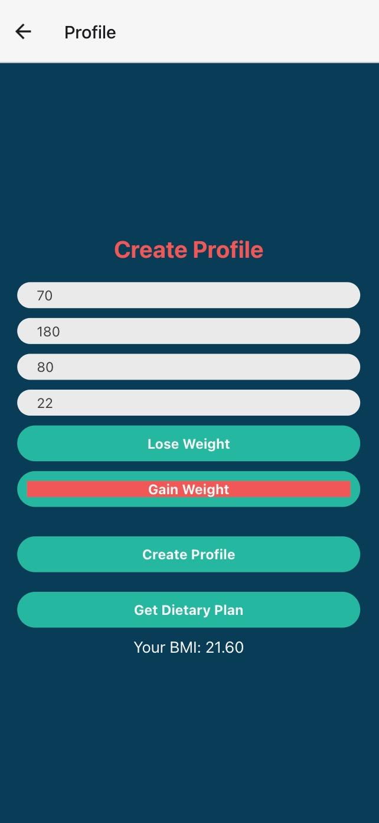
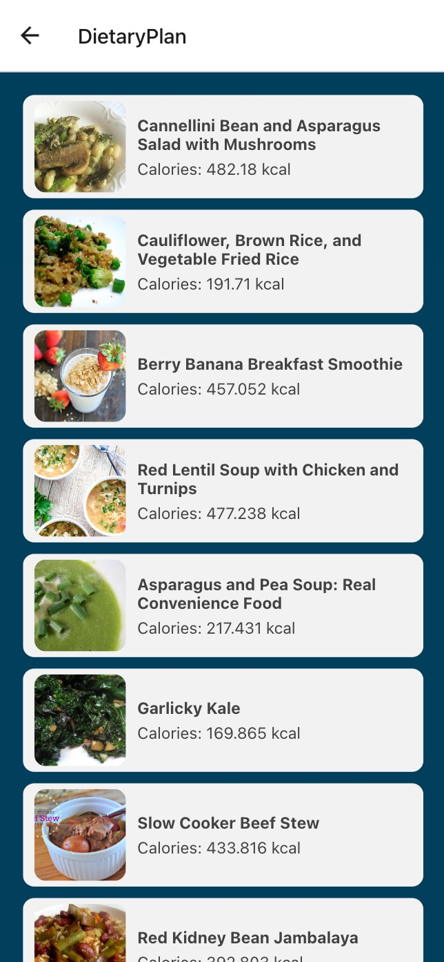
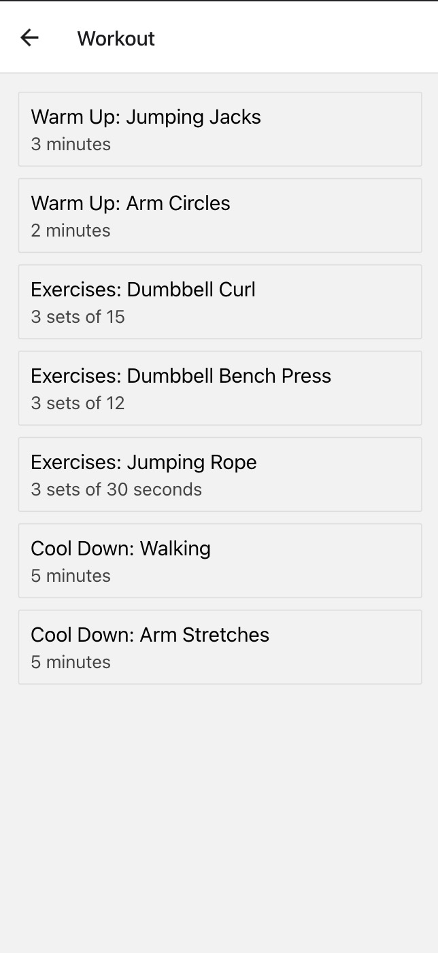

Slide 14
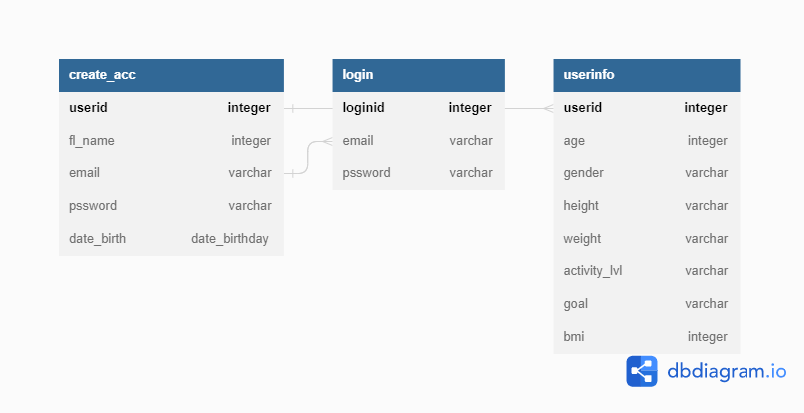
Relational Schema
Create_Acc (userid, fl_name, email, pssword, date_birth)
Login (loginid, email, pssword)
UserInfo (userid, age, gender, height, weight, activity_lvl, goal, bmi)
ER Diagram & Explanation

Slide 15
This current ER diagram consists of three tables; Create Account, Login and UserInfo.
The "create_acc" table stores essential information for account creation, such as a unique auto-incrementing user ID, full name, DOB, and a unique email to prevent duplicate accounts.
The "login" table stores user login information, including a unique login id that changes per login attempt, and is linked to the "create_acc" table through a foreign key referencing the user account's username.The "userinfo" table stores additional information about users, including BMI results, with the "userid" column as a foreign key referencing the "userid" column in the "create_acc" table, indicating that the user information belongs to a specific user account.
The "create_acc" and "login" tables have a one-to-one relationship based on email and a one-to-many relationship based on user account and login attempts.
There’s a one-to-many relationship between the “create_acc” and “userinfo” tables since one user account can be linked to multiple userinfo entries considering the app also tracks the users progress.

Slide 16
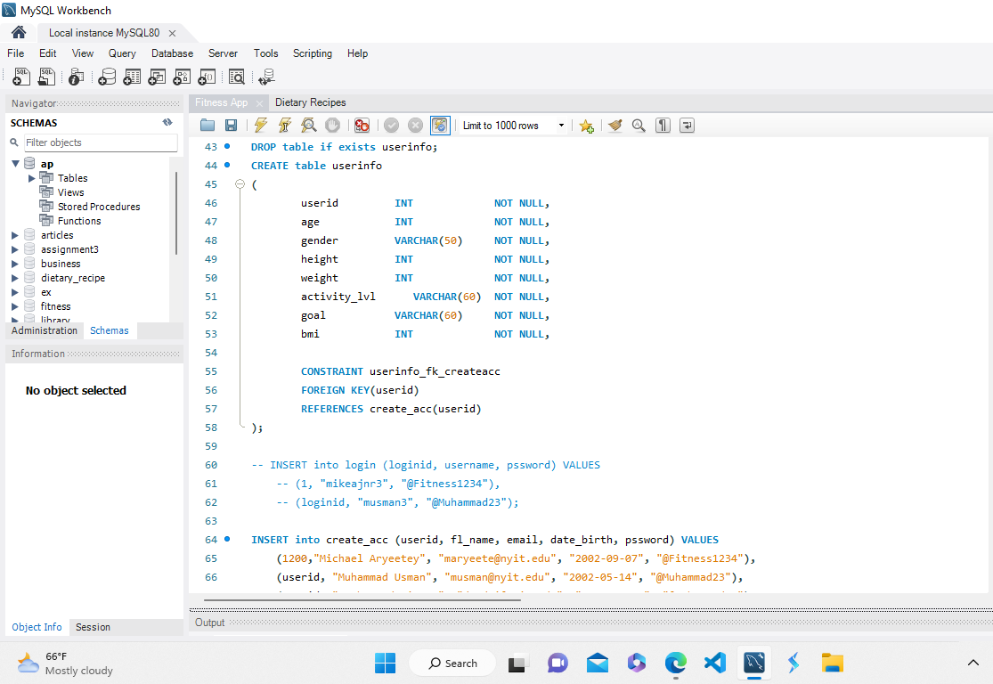
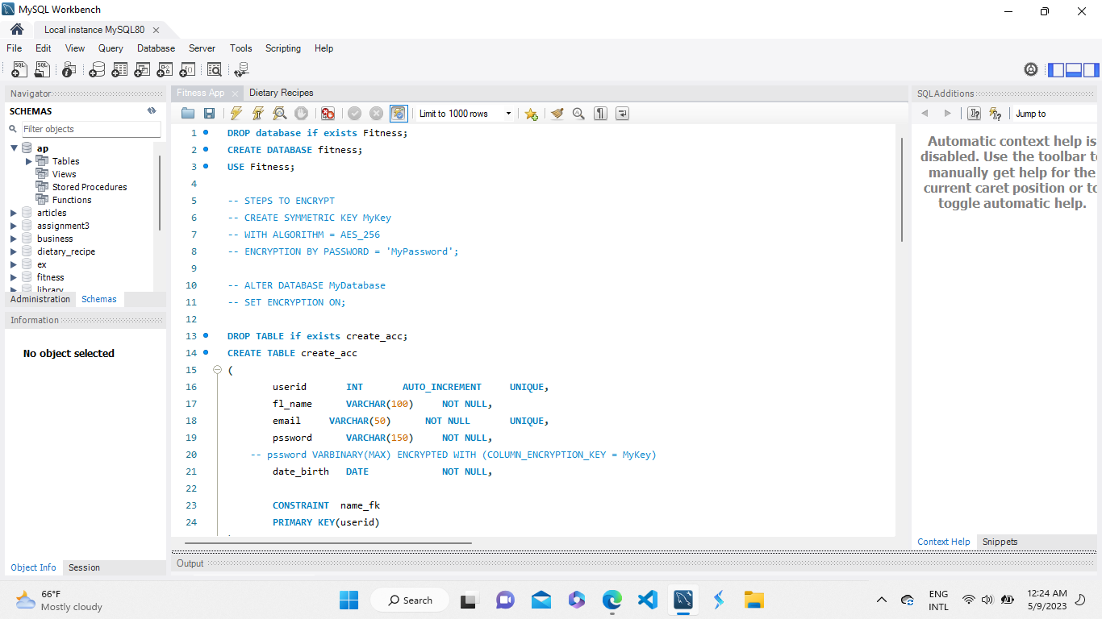
ScreenShots of the Databases

Slide 17
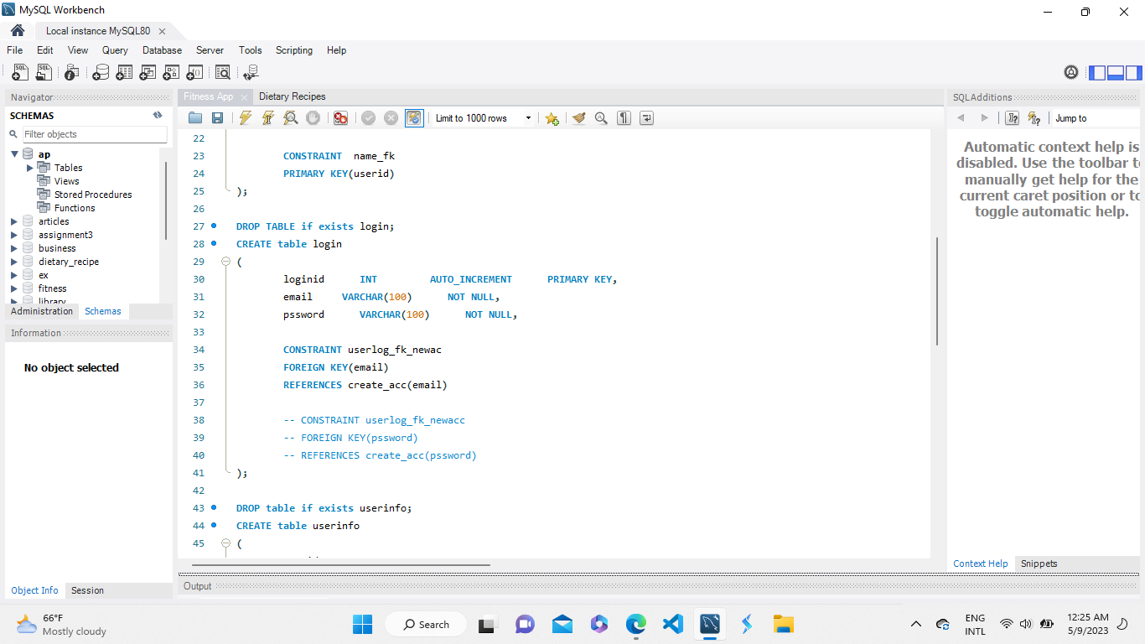
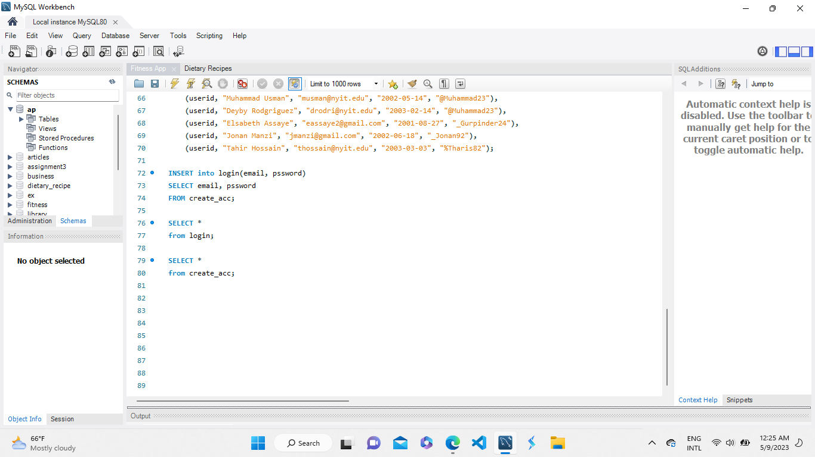

Slide 18
An app that tracks calories and provides a personalized workout routine can be an excellent tool for individuals looking to manage their health and fitness goals. Such an app could offer the following features:
Calorie Tracking: The app can provide a comprehensive food database, allowing users to log their meals and calculate the approximate calorie intake. It can also include a barcode scanner to simplify the process of entering nutritional information. Additionally, the app could provide insights into macronutrient breakdowns (carbohydrates, proteins, and fats) to help users maintain a balanced diet.
Personalized Recommendations: Based on the user's goals, body metrics, and dietary preferences, the app can generate personalized recommendations for daily caloric intake and suggest meal options that align with the desired calorie range. It can also consider any dietary restrictions or allergies to offer suitable alternatives.
Workout Planning: The app can provide a variety of workout routines tailored to individual goals, such as weight loss, muscle gain, or overall fitness. Users can input their exercise preferences, fitness level, and available equipment or location (home or gym), and the app can generate a customized workout plan accordingly. The plan can include recommended exercises, sets, repetitions, and rest periods.
Progress Tracking: The app can allow users to track their progress over time. It can display statistics like calories burned, weight changes, body measurements, and fitness achievements. Progress charts and graphs can offer visual representations of the user's journey, providing motivation and insights into their overall improvement.
Integration with Wearable Devices: To enhance accuracy and convenience, the app can integrate with popular fitness trackers or smartwatches. This integration enables automatic activity tracking, heart rate monitoring, and syncing of data with the app.

Slide 19
Overall, they were generally impressed with the functionality of the app and felt that the main function of the app being the exercises with the timers were very useful when they used it. The main criticism that we got for the app was of how simplistic our UI design looked.
Friends:
They were also impressed about the functionality of the app since this would be the first app that we have created. Their main highlight of the app is both the number of workouts available as well as the counter used to keep track of the calories lost, workouts completed, and time spent working out throughout the session. Their main criticism was the lack of profile customization and leaderboards; having these features would encourage and serve as motivation for their workout.
Feedback:
Family members:

Slide 20
HealthBoost is a web and mobile app that offers personalized nutrition and workout plans based on users' dietary restrictions, health goals, and fitness levels. The app features an advanced algorithm that generates customized nutrition plans and offers recipe recommendations, meal planning, and real-time progress tracking. It integrates with popular fitness tracking devices and apps and provides exclusive premium content through a subscription-based model for businesses. The app's user-friendly interface, built with React Native, and secure backend, powered by Node.js and SQL, ensure a seamless and efficient user experience.
Conclusion:

Slide 21
Future Directions:
HealthBoost has potential for further enhancements such as social features, machine learning and AI algorithms, and expansion to a global audience.
Integrating with wearable devices and incorporating gamification elements can make the user experience more engaging. Overall, HealthBoost provides a comprehensive wellness solution with its advanced algorithm, real-time progress tracking, recipe recommendations, and user-friendly interface.

Slide 22
References
[1] Easy Tiger Apps, LLC, Exerprise, Both in App and Google Play Store. March 2023 (Last Updated).
[2] Zero: Fasting & Health Tracker, Both in App and Google Play Store. April 2023 (Last Updated).
[3] FastEasy: Intermittent Fasting, Peloton, Both in App and Google Play store. March 2023 (Last Updated).
[4] Lose It! - Calorie Counter, Both in App and Google Play store. March 2022 (Last Updated)
[5] Happy Scale -Weight Loss Tracker, Both in App and Google Play store. February 2023 (Last Updated)
[6] Noom - Healthy Weight Loss, Both in App and Google Play store. March 2023 (Last Updated)

